Slide 1
Parent Engagement Strategies for School Staff to Increase Student Achievement
(Insert presenter’s name)
(Insert date)
(Insert School Logo)
Notes:
Say: Welcome teachers! Today, we’re going to explore a critical area that influences student achievement. We’ll explore parent engagement and align some strategies to increase student achievement at our school.
Note- This presentation may be used to meet the How to Partner with Parents Staff Training requirement.

Slide 2

LAUSD’s Mission and Core Beliefs
MISSION: Every LAUSD student will receive a high-quality education in a safe, caring environment, and every student will be college-prepared and career-ready.
Core Beliefs:
Start with students
Families are our partners
Success is in the classroom
Diversity is our strength
Effective teaching, leadership, and accountability are the keys to our success
2
Notes:
Say: Let’s start with our district’s mission and core beliefs. LAUSD’s mission and purpose is to ensure that every student in our schools receives a quality education in a safe and caring environment so that every student will be college-prepared and career-ready. This mission comes from five strong beliefs that our staff at all levels hold: (READ beliefs as they move in AND EXPLAIN).
(Click) The second goal, as you can see, clearly emphasizes that: “Families are partners”!

Slide 3
Benefits of Parent Engagement
BENEFITS TO THE STUDENTS
BENEFITS TO THE SCHOOL
Improved teacher morale
Higher ratings of teachers by parents
More support from families
Higher student achievement
A better reputation in the community
Higher grades, test scores and graduation rates
Better school attendance
Increased motivation and better self-esteem
Lower rates of suspension
Decreased use of drugs and alcohol
Fewer instances of violent behavior
Notes:
Say: Decades of research shows the benefit of parent engagement. Through authentic parent engagement, student achievement increases. According to research, some of the student benefits of parent engagement include (click) higher grades, test scores, and graduation rate, better school attendance, increased motivation and better self-esteem, lower rates of suspension, decreased use of drugs and alcohol, and fewer instances of violent behavior.
(Click) In addition, through authentic partnerships with parents, schools gain the following:
(Click)Improved teacher morale, higher ratings of teachers by parents, more support from families, higher student achievement, and a better reputation in the community.

Slide 4

Define Parent Engagement
How do you define parent engagement?
Notes:
Say: The benefits of parent engagement are stated in the previous slide; let’s define this goal a little further. we’ll ask you a question now. How do you define parent engagement?
Get responses from the teachers, paraphrase, and record responses on the chart paper.
Note- write “How do you define parent engagement?” on the poster paper in advance and have markers available for recording information. Multiple poster papers may be needed for this activity.

Slide 5

Session Objectives
Analyze the benefits of parent engagement by examining parent engagement research
Strategize to increase parent engagement opportunities at school
Explore parent engagement professional development opportunities at our school
Notes:
Say: For today’s presentation, as we attempt to examine parent engagement at our school and explore ways to improve, we have two objectives: We will analyze the benefits of parent engagement by examining research, and then collectively strategize to increase parent engagement at our school.
Say: Which one of these objectives align best with your own professional learning goal? (Pause) Share your thoughts with your shoulder partner
(60 seconds)

Slide 6
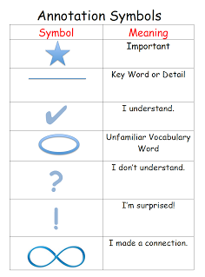
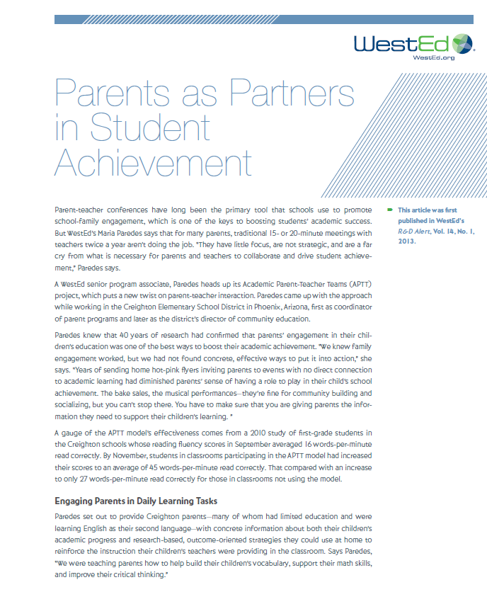
Research shows:
Notes:
Say: Before we delve more into the subject of today’s presentation, let’s start with some research. There is an article in your packet that was published by WestEd. While we’re reading the article, please use the Close Reading annotation symbols to mark your reading material. We’ll use a protocol soon to share our annotated items.
The article is about Parents as Partners in Student Achievement. We’ll take 10 minutes to read the article and annotate along the way.

Slide 7

First Turn, Last Turn Protocol
In turn, share one annotated item, but do not comment on it.
Group members comment in round-robin order about the item.
The initiating person shares his/her thoughts last.
Repeat pattern in sequence around the table.
Notes:
Say: Now, we’ll create groups of 5. Let’s line-up according to our date of birth (January on the left, February after that and so on…). We’ll number off by 5s and create groups accordingly.
Note- allow participants to settle into new groups.
Say: We’ll use a protocol called “first turn, last turn” to hear from each other. In your group, identify the person whose first letter of the first name comes first in the alphabet. That person will begin the process of sharing his/her annotated item. Please note that we’ll follow the sequence outlined on the slide, meaning that the person who first shares the annotated item will withhold his/her comments until everyone else shares their thoughts. In the counter-clockwise order, everyone else in the group will comment on the annotated item; the initiating person will share his/her thoughts at last.
Note- allow 15 minutes for this activity.

Slide 8
Developing Teacher Skills and Spreading the Word
Professional Development and support for the teachers
Share student performance data
Introduce academic standards in a parent-friendly language
Model field-tested activities for home practice
Notes:
Say: Going back to the article we read, the key components of successful parent engagement is quality professional development for teachers. The professional development sessions that promotes knowledge of (click) how to introduce academic standards in parent-friendly language, (click) how to share pertinent student data, (click) and how to model field-tested activities for facilities to practice at home were highlighted as successful strategies.
Say: Which one of these practices are present at our school?

Slide 9
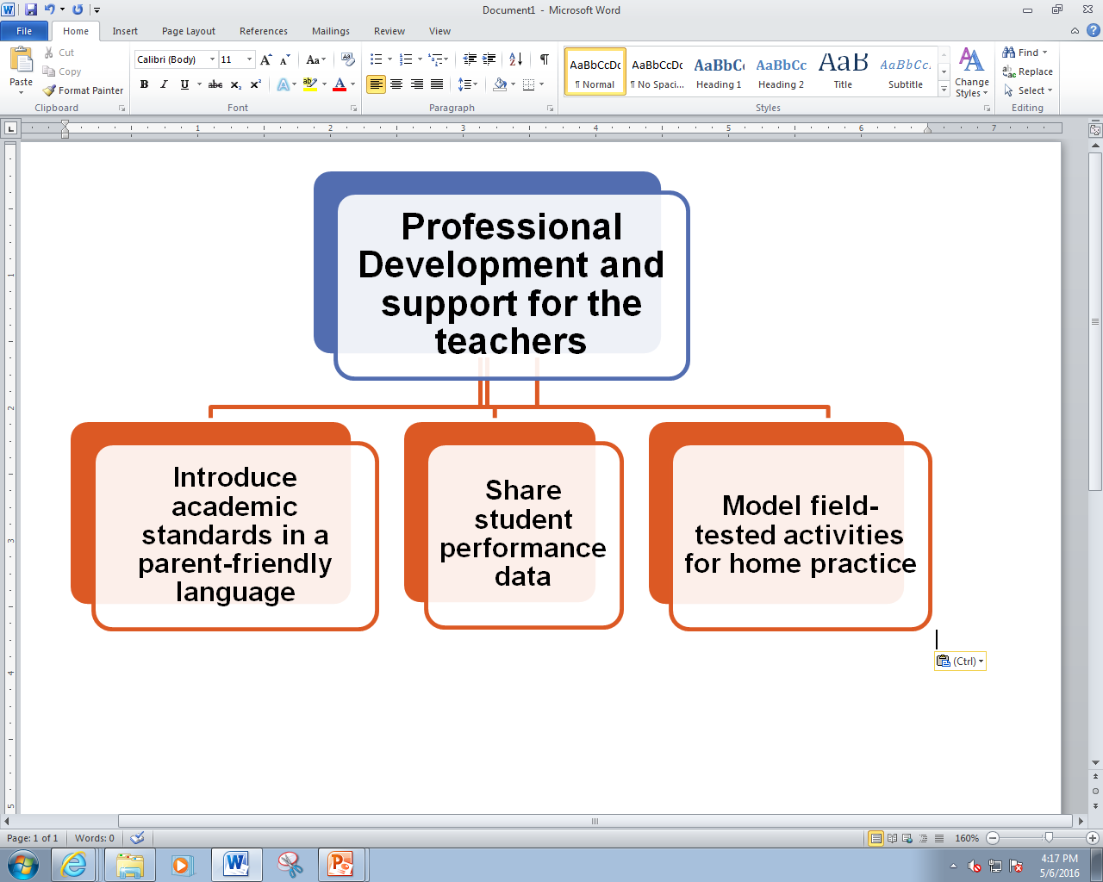




Introduce Academic Standards
Source: http://www.cgcs.org/page/366
Notes:
Say: The first item from the previous slide is about sharing academic standards. There are many ways to communicate academic standards to the parents. Perhaps, the most well-put-together documents are found at Councils of the Great City Schools website (http://www.cgcs.org/page/366). These documents, called Parent Roadmap, contain easy to understand academic standards for all grades. These documents are also available in Spanish.
Please take a few minutes to read 6th grade ELA Parent Roadmap.
What are some of your observations?
Note: take as many responses as time permits.
For this activity, print and make copies of one Parent Roadmap that’s most relevant to the teachers. In addition, you may also print multiple Parent Roadmaps to reach a boarder audience.

Slide 10

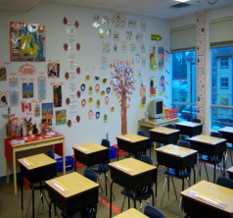
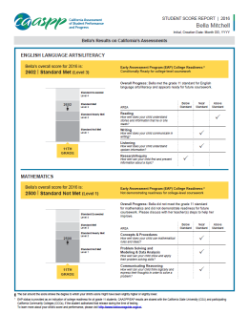

Share Student Performance Data
Observation data
Exit slips, quizzes, tests, and exams
Formative assessment
Report Cards
From the classrooms
From Standardized Tests
CAASPP Report
It’s usually more engaging if students speak and elaborate their performance data to their parents!
Notes:
Say: The performance data are generally obtained from two sources. (Click) from the classrooms come observation data, exit slips, quizzes, tests, and exams, formative assessment data and report cards. (Click) There is also additional data from the Standardized tests. CAASPP reports, for example, provides summative information of a child’s progress. (Click) Please note that when student present their own data to their parents, both students and parents are fully engaged.
Say: How does a teacher ensure that students are able to articulate their performance data to their parents?

Slide 11
Home Practice Activities
On-line Resources
Khanacademy.org
A free website with video tutorials (K-12). Students receive points and badges for mastering concepts. Tutorials available in English, Spanish and many other languages.
Make and Take
Memory Games
High Frequency Words
Starfall.com
A free website that helps students learn how to read.
Youcubed.org
A free website where students can engage in math games that teach fractions, algebra, and geometry.
Times Table Games
http://achieve.lausd.net/Page/10417
Parent, Community, and Student Services website offers modules for High Frequency Words and Reading Comprehension.
Notes:
Say: Internet ushered in a new era of learning. There are many wonderful website that students and parents could use at home to reinforce learning. Starfall, for instance, is great website for children to develop phonemic awareness and reading skills. The site is engaging and children and parents can spend time together on the site. Youcubed.org is another website where children can learn complex math skills through carefully designed games. This too could be a place for both children and parents to spend time on. Finally, Khan Academy is yet another website where children can watch tutorial videos and engage in solving problems.
Say: How many of you have recommended some of this sites to the parents? What are other sites that you might want to recommend to our parents?
Note- a brief demonstration of the these sites might be necessary for better understanding of the usefulness of the sites.

Slide 12
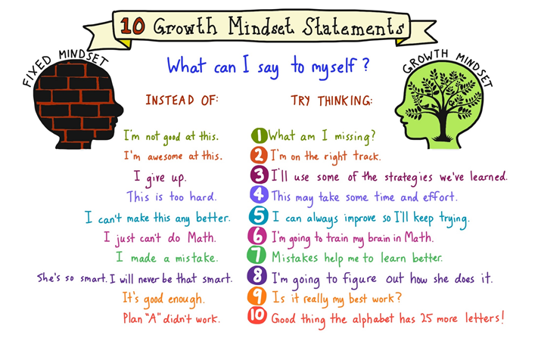
Home Practice Activities
Constructive conversation is another way to engage a child.
Examples:
Tell me something you learned today.
Tell me something that made you laugh today.
What’s the most difficult thing you did at school today?
What was the goal of this assignment?
Growth Mindset Statements
Notes:
Say: Last, but, not least, the importance of constructive conversation between and child and a parent is invaluable. Encouraging parents to use open-ended questions is an imperative. Examples of open-ended questions might be: (click) tell me some thing you learned today, or (click) tell me something that made you laugh today, or (click) what’s the most difficult thing you did at school today?, or (click) what was the goal of this assignment?
Say: In your packet, you also have a Growth Mindset hand-out. This hand-out suggests alternate ways of communicating with children. Please take 2 minutes to read the content of the hand-out. (Allow 2 minutes)
Say: How might you be able to utilize this document with the parents?

Slide 13
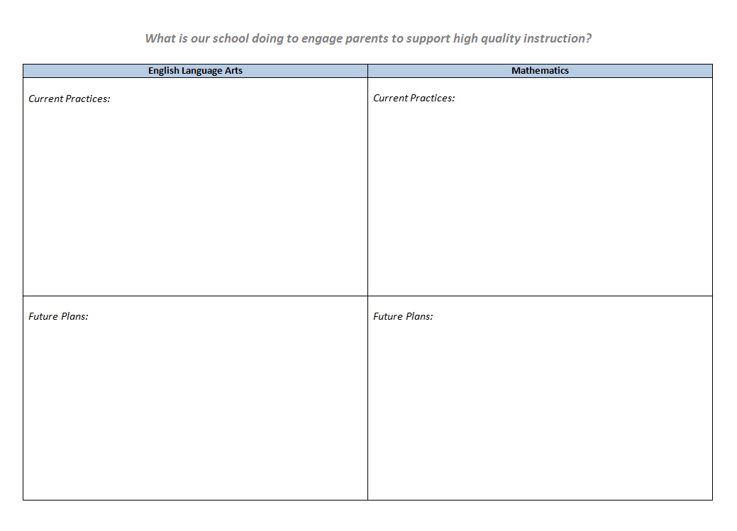
Strategize
Notes:
Say: Now that we read some research and looked at some benefits of high parent engagement, let’s attempt to strategize to support parent engagement at our school; let’s use this template that you have in your packet (as shown on the screen) to assess and generate some ideas. The template has English Language Arts, Mathematics, English Language Development, and Graduation and College readiness listed; each item is categorized by “current practices” and “future plans”. Let’s take next 10 minutes to list all the current practices and our future plans (and ideas) regarding these categories. Record any thoughts or ideas you have that is either promoting or will promote parent engagement in these four specific areas.
Note- this is an individual activity. Allow 7 minutes for participants to record their responses.

Slide 14
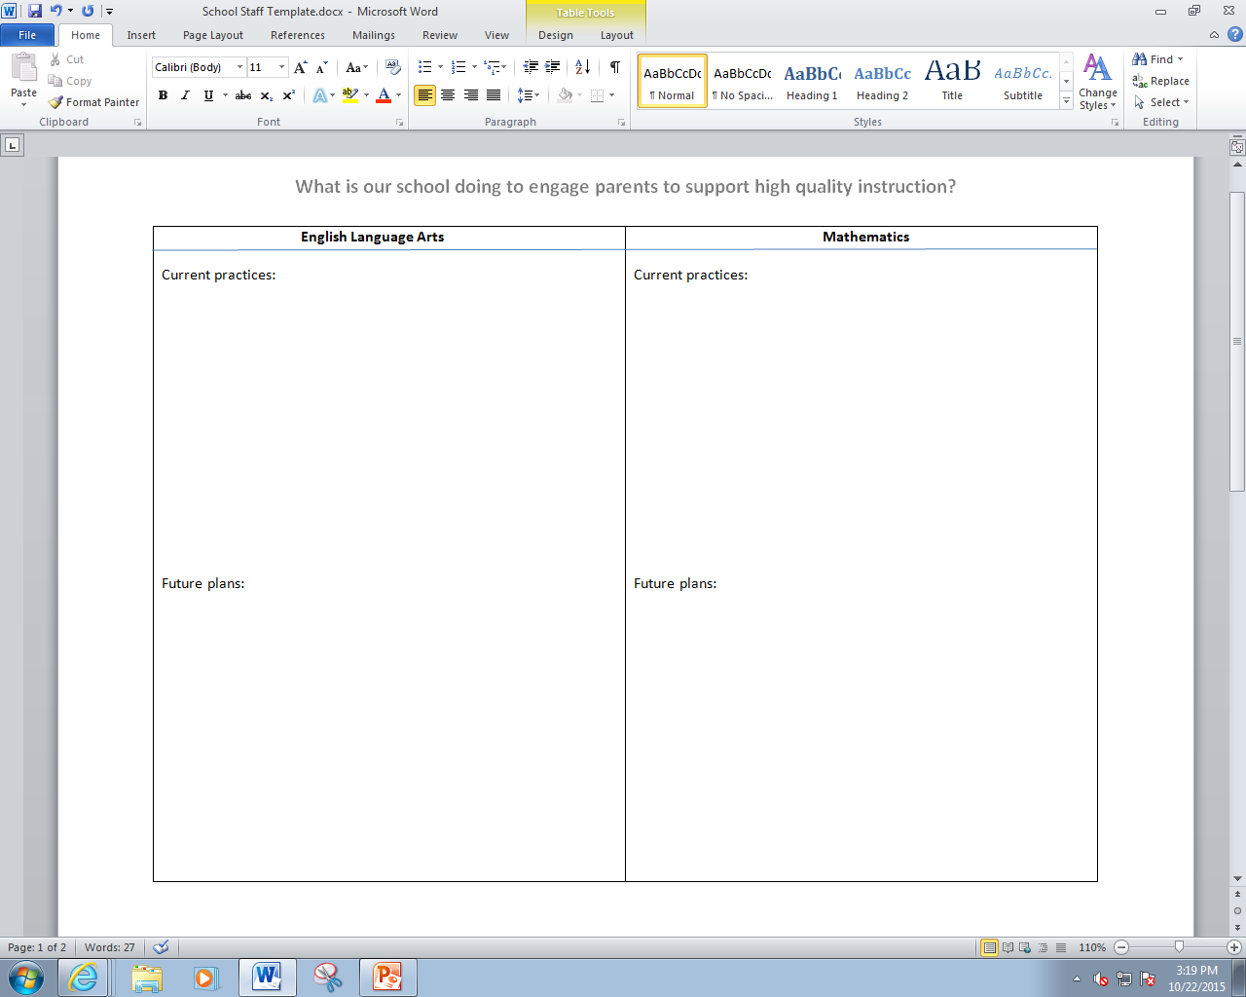

Strategize
Who is responsible?
principal (P)
coordinator(C)
counselor (CN)
teacher (T)
other staff (OS)
Notes:
Say: Please take two post-it notes. On the post-it notes, write two practices, either a current practice or a future plan, that you feel are imperatives for increased parent engagement at our school.
Note- Allow 3 minutes for this activity.
Say: There are four posters around the room with titles English Language Arts, Mathematics, English Language Development, and Graduation and College Readiness. Please go to the poster that corresponds to the entries you have on your post-it notes. Place the post-it notes on the posters.
Note- allow 2 minutes for this activity.
Say: Please stand by the domain that you feel most passionate about. Now, read the entries that are on the poster and cluster them in alike groups. Lastly, write the code (P, C, CN,T, or OS) next to the practices to indicate the person who might be responsible for implementing the practices.
Note- allow 7 minutes for this activity.

Slide 15
How do you think we might be able use the data we gathered today?
Integrate data into school’s Parent Involvement Policy.
Incorporate data to develop a comprehensive School-Parent Compact.
Design and conduct parent workshops.
Share data with the School Site Council members.
Share data with the advisory councils.
Use this data to assess volunteer needs at the school.
Use this data to for budget allocation purposes.
Use this data to enhance communication among the stakeholders.
Notes:
Say: In addition to incorporating your input data from today’s professional development, how else might we be able to use the data we generated in this room?
Allow a few minutes for responses.
Say: The data gathered from today’s meeting may be used for (click) school’s Parent Involvement Policy and Home-School Compact. This data may also be used to (click) design parent workshops, (click) inform School Site Council members as they review SPSA, (click) share data with advisory councils, (click) use this data to assess volunteer needs at the school, and (click) perhaps, this data might be useful to enhance communications among the stakeholders.

Slide 16

Revisit our definition of parent engagement
Has your definition of parent engagement changed?
Notes:
Say: At the beginning of our session, we defined parent engagement. Has your definition changed or has it stayed the same?
Note- you may have a pair-share or a whole group discussion based on the question.

Slide 17
Thank you!
Productive collaborations between family and school, therefore, will demand that parents and teachers recognize the critical importance of each other’s participation in the life of the child.
------ Sara Lawrence Lightfoot
Harvard University
Notes:
[Q & A time]
Note: Please collect all data from the posters for planning purposes. Alternately, you may also take pictures of the entries on the posters.

